Slide 1
Zoom Orientation
For Study Leaders

Slide 2
Welcome
Agenda:
How to get ready for your course on zoom
What to do the day of
Your Zoom license

Slide 3
Have the latest version of Zoom downloaded.
which is 5.10.1
Upon entering your Zoom meeting, go to Start Video then Video Settings then Statistics then look for the current Version
It will say which version you are using……

Slide 4
this is what you’ll see
look here

Slide 5
open the drop down list and select check for updates
To check for updates within the mac os application:

Slide 6
this is what you’ll see if you aren’t on the latest distribution

Slide 7
To check for updates within the pc application:
click on your profile image which opens the drop down list, then select “check for updates”, the process from here is the same as for a mac

Slide 8
Manual download
Zoom Desktop Client (PC, Mac, or Linux)
Clicking on download from the link at https://zoom.us
Directly from one of the following links
https://zoom.us/support/download
https://zoom.us/download
https://zoom.us/download2

Slide 9
Test your equipment – Set up your space
Check your room lighting – light from the front is better than the back
Close doors and windows to keep household sounds out
Check your background – is it okay for your students to see?
Check your connection – be wired if you can. If you are wireless, sit close to your router and ask household members not to use the internet
Check your microphone volume settings - if using the built-in mic in your device, sit close to your computer

Slide 10
Before the first class
Practice
Practice by yourself
Practice with someone else that is not on the same computer
Take a Zoom SL Training Class as many times as you want – we want you to feel comfortable. Just ask.
Need more Review? the Zoom help center has training videos. This one: “Host and co-host controls in a meeting” is especially relevant.

Slide 11
You should get your Zoom code and password the day before class is to start. 123 4567 890 Class3842
If you haven’t received the name of your Zoom Helper, contact the office to find out who it is.

Slide 12
Day of your class – HOW TO GET INTO ZOOM:
If you just click on the URL you were given you won’t end up as the Host!!!
Just before your class is to start…...
Go to Zoom.us…..
….. then go to My Account
When Account Profile opens, check to be sure Osher is the Account Owner

Slide 13
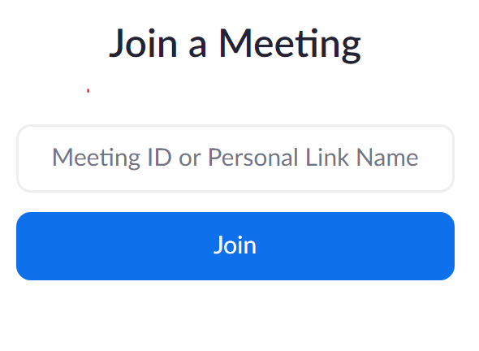
Day of your class – HOW TO GET INTO ZOOM:
If Osher is not the account owner go back to My Account and sign out and sign back in using the email you gave the Osher Office.
Now you must go to Join a Meeting…
…to enter you meeting ID codes.
click on join

Slide 14
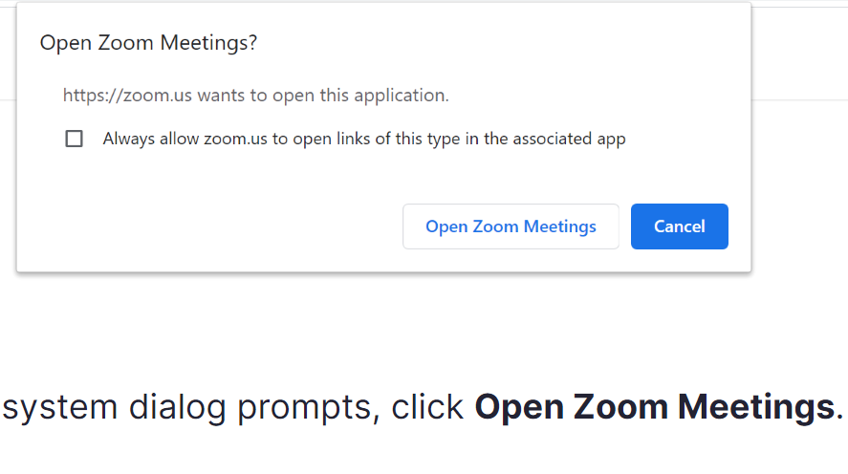
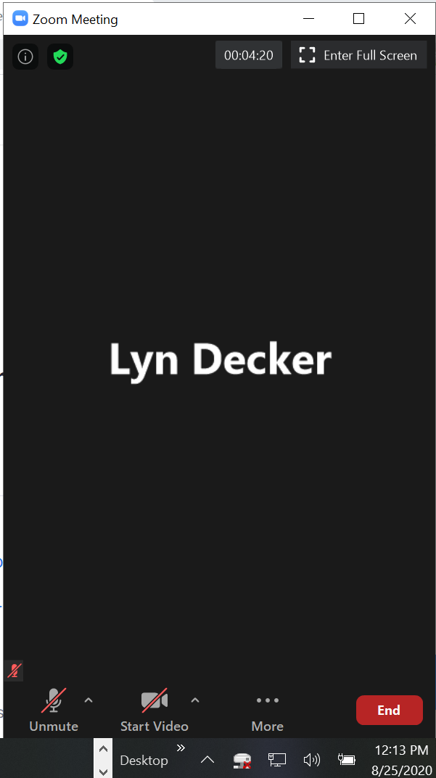
Day of your class – HOW TO GET INTO ZOOM:
You are almost there….
7. Click on Open Zoom Meeting
8. Once your screen is open
a)Enter Full Screen, b) Unmute, Start Video, and c) check for
the Security shield – YOU ARE NOW GOOD TO GO…
Your Name

Slide 15
Day of your Zoom class cont…..
You should be able to log in 15 minutes before the start of class
Check to be sure you are the Host or Co-host
You will see the “Security” shield in the tool bar if you are
Contact the office at osher@cmu.edu if you are not

Slide 16
Day of your Zoom class cont.….
You have a Zoom Helper:
If you don’t know who your Zoom Helper is– ask the class if a helper is present and then make them a co-host. Do this by going to Participants and click on the three dots – pick “Make co-host” next to the name of the person who will be your helper.
Tell your Zoom Helper what you want them to do: (some suggestions)
Mute people
Take chat questions
Let you know when it is time for a break
Let you know when you have 10 minutes left of class time

Slide 17
Day of your Zoom class cont.….
Some students don’t have a microphone or a camera in their system – they can only see and hear the course from their end, you’ll only see their name. To confirm this, go to Participants – find their name – if there is no microphone or video icon then you’ll know.
Decide if you want people to join your course once you’ve started.
If you don’t want interruptions, lock the course (under security button) after you have given your class reminders
If you plan on locking each time we suggest that in your introductory email to your students you advise them you will be locking the class after 10 minutes, so please come early

Slide 18
About the Zoom License
You should have accepted our Zoom license invite – once on you’ll stay on from term to term
Osher at CMU has:
40 Zoom licenses
1 Webinar license
3 time slots for classes to be held
½ hour between each class – 15 minutes to get in and started and 15 to get out
At the beginning of each term, all scheduled Study Leaders who are not already on our license will receive a Zoom invitation.
If someone already as a Zoom account of their own OR a “.edu” Zoom account they can use their own BUT will have to set up their own course and email the codes to the office.

Slide 19
Zoom License continued…..
When a SL accepts our invitation they come on as a “basic” license
We typically have over 100 Study Leaders each term so the first session SLs will be put onto the licenses first and the license turns from “basic” to full “license” – unlimited time / up to 300 students
As course are completed, the next Study Leader’s license account will go from Basic to License

Slide 20
Zoom License continued…..
Log into Zoom.us and sign in
– look at the profile for the following:

Slide 21
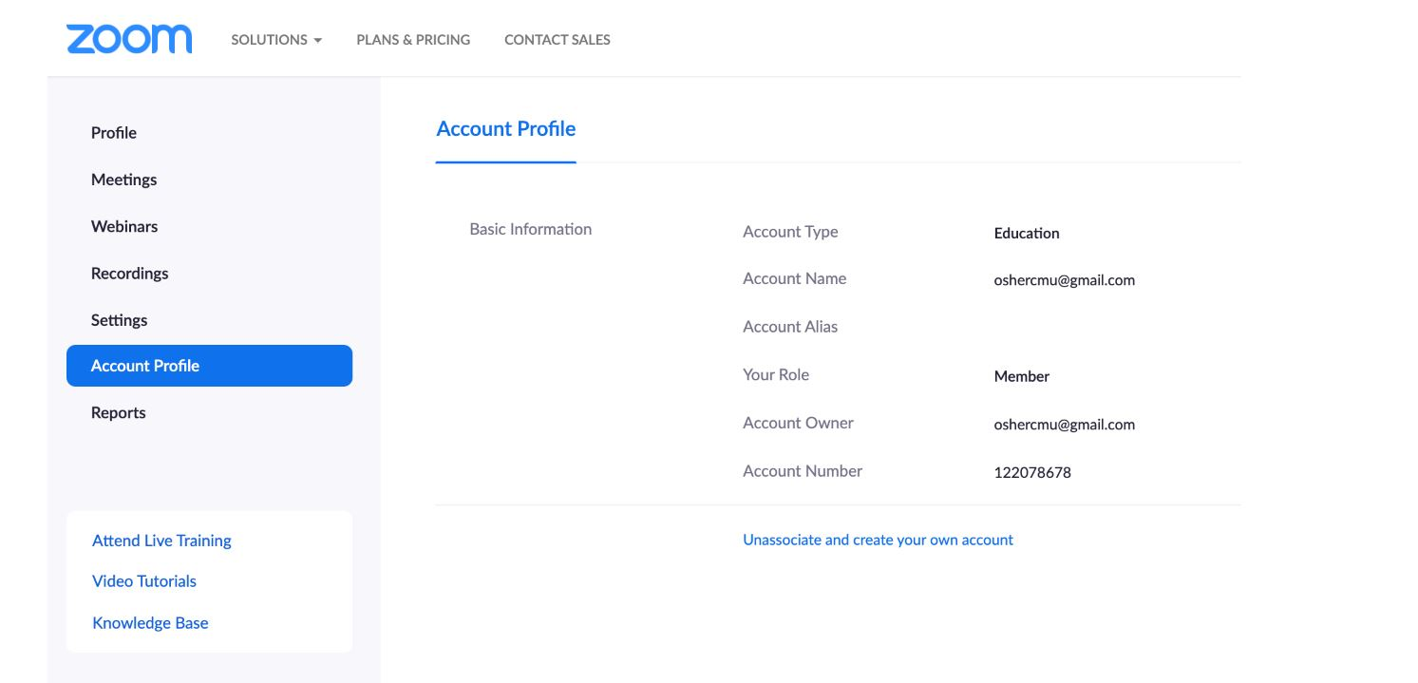
Osher owns this account

Slide 22
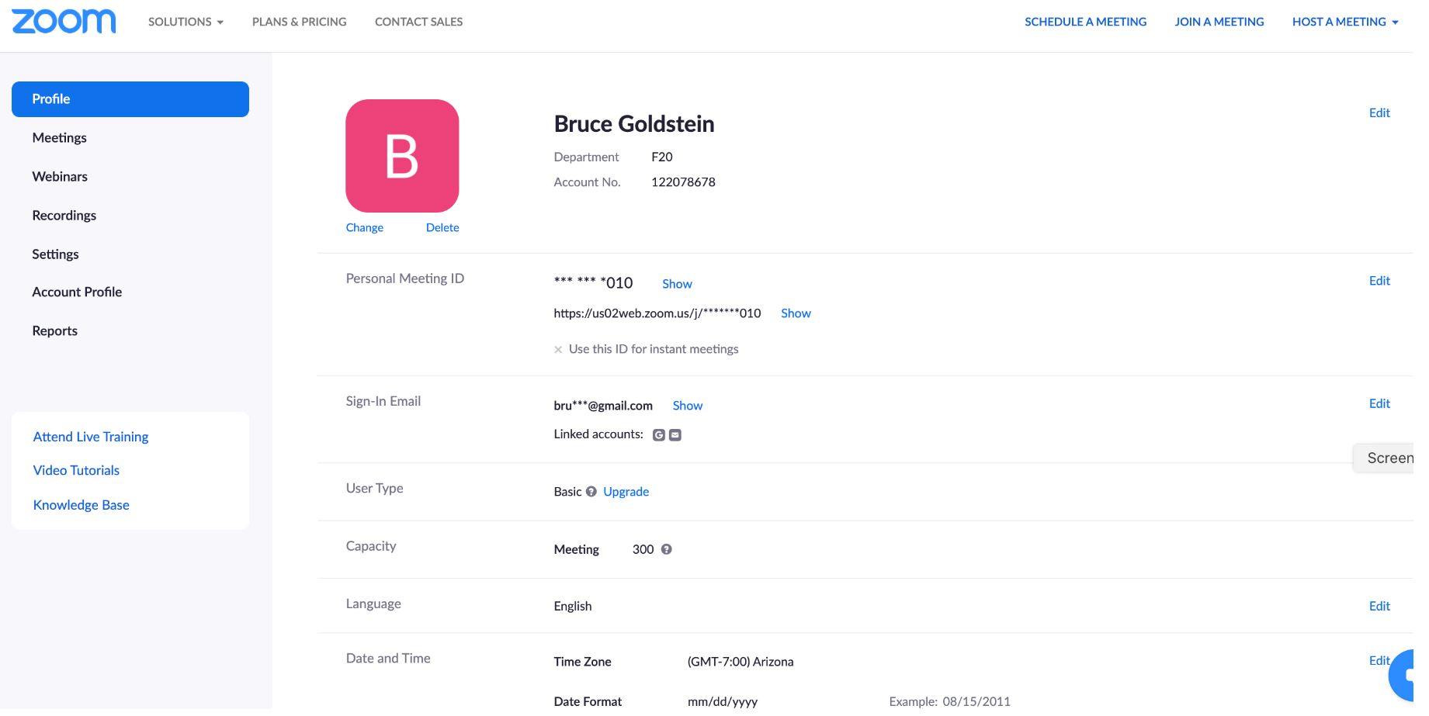
Your Name
Department: will show term.
F20 is fall 2020
Your own email will be here

Slide 23
If you have two Zoom accounts – go to Profile and sign out of the one to be able to sign into the Osher License Zoom if you are using it.

Slide 24
Your Zoom Class Screen:
Click here to see your CPU usage & your Zoom version
This button show you are the host and is key.

Slide 25
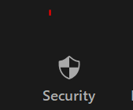
You are the Host or Co-Host
If you see the “Security” button you know you are the Host or Co-Host
This is where you can:
Lock the Meeting
Enable the Waiting Room
Allow Participants to:
Share their screen
Chat
Rename themselves
Unmute themselves
Remove participants

Slide 26
Tell your students how you’ll run the class – remind them each week.

Slide 27
How do you plan to take questions?

Slide 28
Remind Students to:
Mute themselves – to prevent background noise from disturbing the class
Turn off their cell phone so it doesn’t go off during class
Turn off Video – if they are walking around, eating, or go on a break
Raise Hand and/or Use Chat feature to ask questions

Slide 29
Be Ready to Show your Show!

Slide 30
Clean Up Your Zoom Room……. Before you start to Zoom
Quit all applications you won’t be using
Minimizing does NOT work
Make sure to quit your email or turn off new mail notifications sounds, otherwise the class will hear each and every one that comes in!

Slide 31
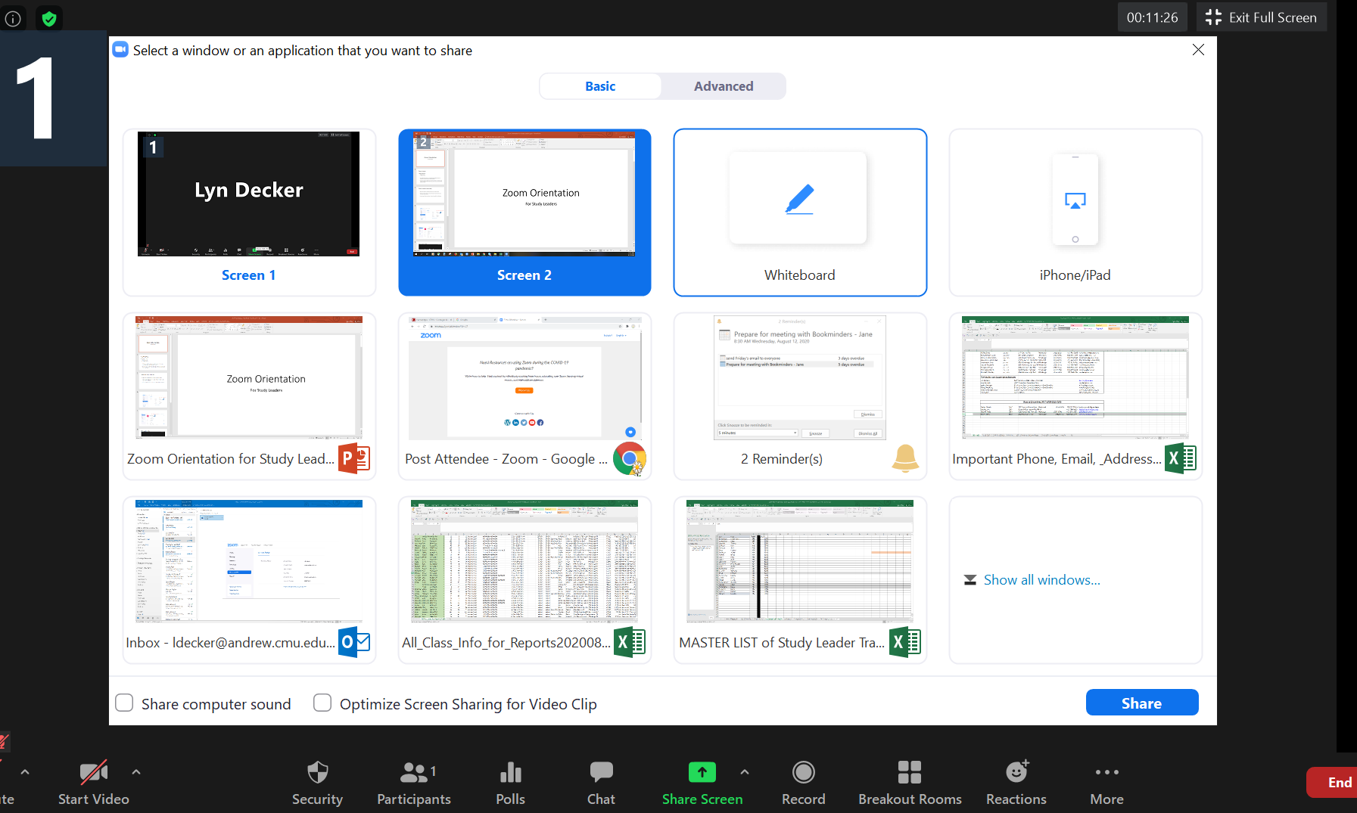
This is too messy. Close off everything not needed for your class.

Slide 32
Have your PowerPoint ready to go!

Slide 34
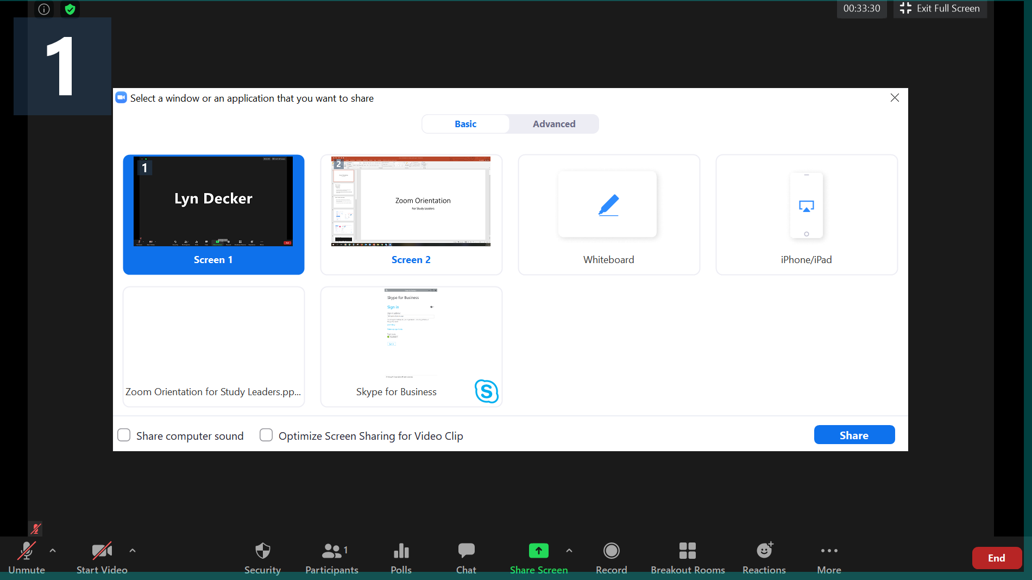
This is best – only have open what is needed for your class.
Once you highlight what you want to show – click on share

Slide 35
Remember to check off these buttons if you are using a video, music, or YouTube.
Be aware that paid streaming applications like Netflix, Hulu, and Amazon Prime Video may not work over Zoom because of copyright issues. They have built-in properties that recognize when screen sharing is being used and will blank out the screen to the users you are trying to share to.

Slide 36
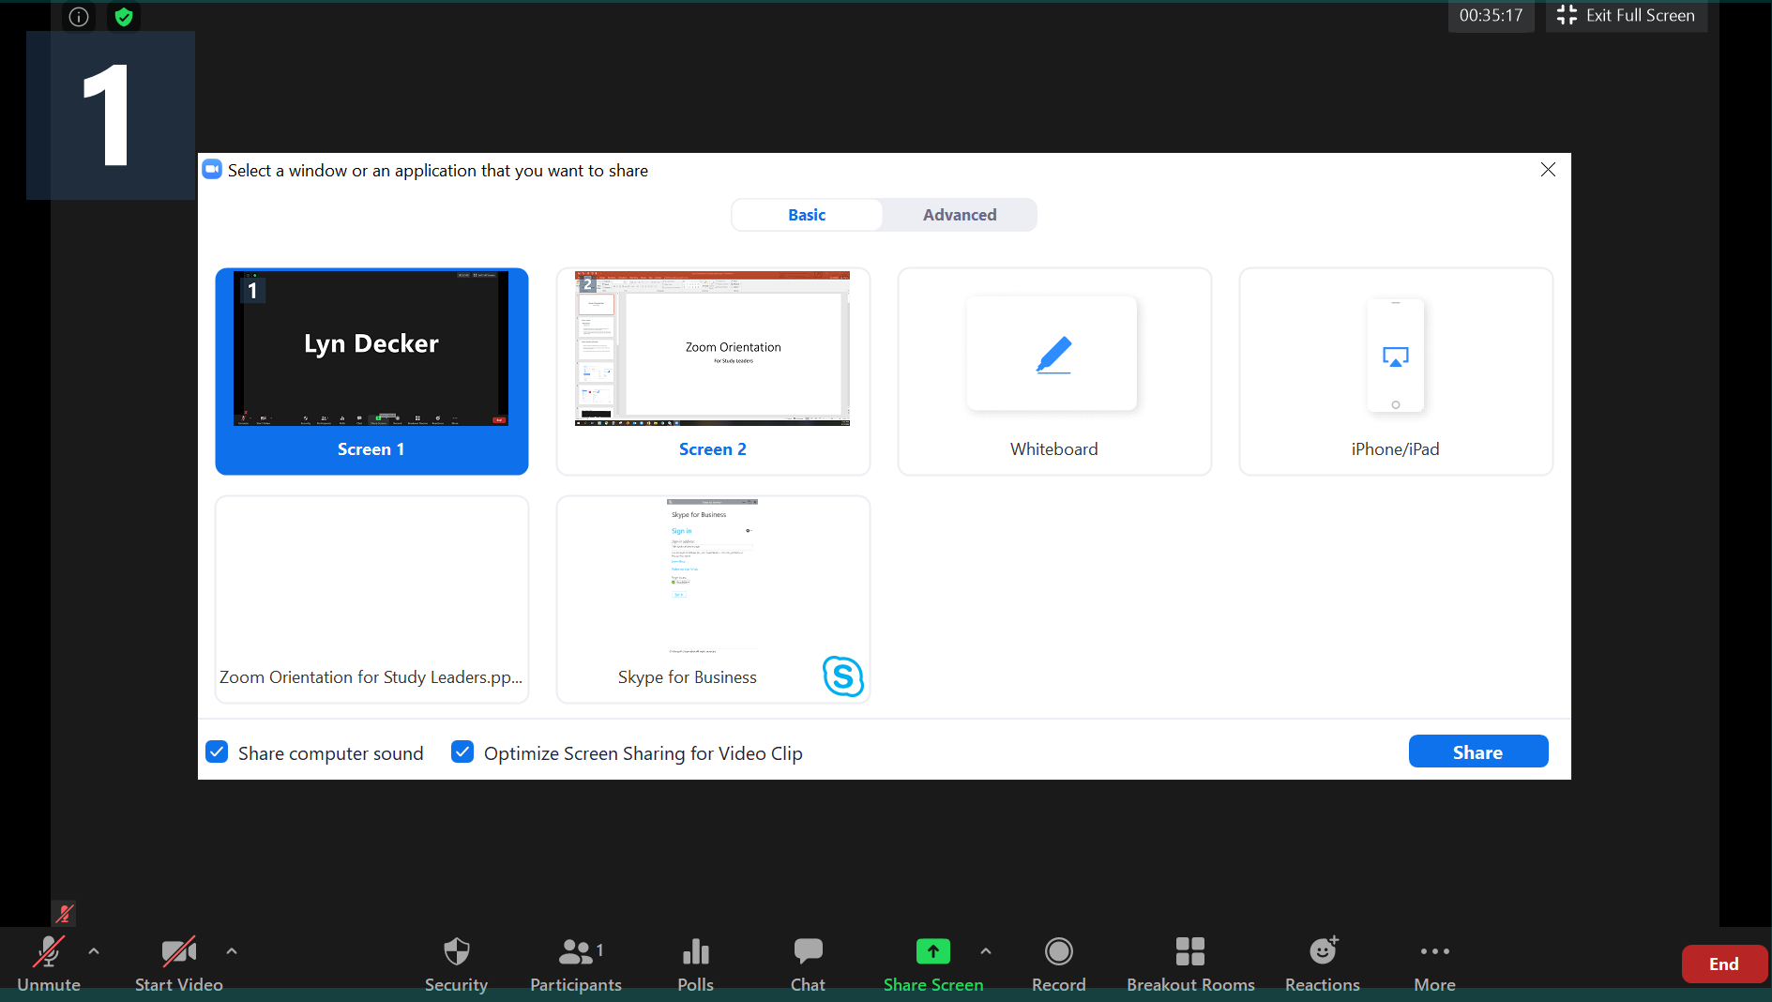

Slide 37
Your tool bar when you are sharing:
When you want to stop sharing click here.
When you are done making changes click on the mouse

Slide 38
It is time to practice…..
Open your PowerPoint and share with the group
Find where you can raise and lower your microphone
Find where you can check your current Zoom version

Slide 39
Questions……
?

