Slide 1

Starting Out
Financially Strong
The Northwestern Mutual Life Insurance Company — Milwaukee, WI
Scott Beasley, CFP®, CAP® ChFC®, CLU®, RICP®
Financial Advisor
Arkansas State License #:19098475
California State License #:4068806
Northwestern Mutual is the marketing name for The Northwestern Mutual Life Insurance Company (NM), Milwaukee, WI (life and disability insurance, annuities, and life insurance with long-term care benefits) and its subsidiaries.
29-5184-24 (Rev 0623)
Notes:
Hello, and thank you for being here today. I’m [Scott Beasley]. I am a [financial advisor] with Northwestern Mutual.
[Note to advisors/presenter]:
Depending on your presentation style, prompt your audience to feel free to ask questions as you go.
[Note to advisors/presenters]:
there are two companion pieces that compliment this seminar that can be accessed from the Marketing Commons:
29-5437 Building a Strong Financial Foundation
29-5135 If You Live For It, We'll Help You Plan For it.

Slide 2
What do you want for your future?
2
Notes:
I’d like to start by asking a question.
[Audience Poll] What do you want for your future? We all have our own hopes and dreams for our families, our jobs, where we want to live, how we’ll spend our time … what are yours?
[AUDIENCE RESPONDS]
No matter what our goals are, the best way to reach them is usually through planning. And because most of our goals need to be funded in some way, what we’re really talking about is financial planning.

Slide 3
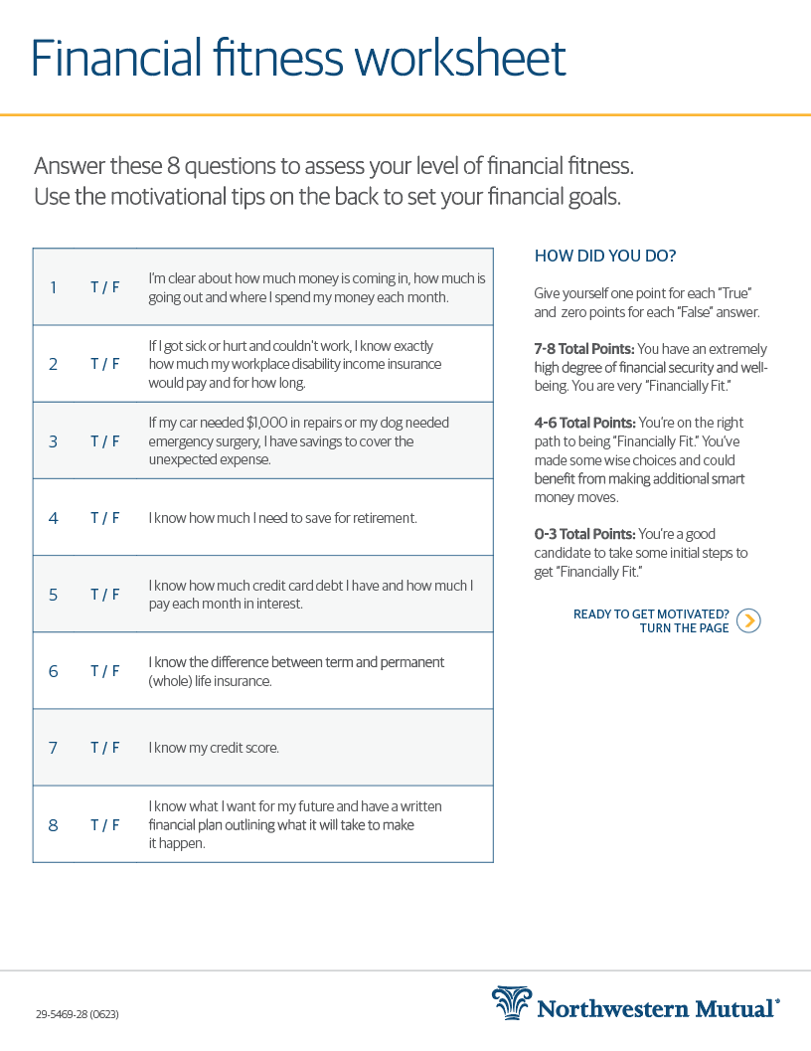
Financial Fitness Worksheet
Answer these 8 questions to assess your level of financial fitness.
3
Notes:
To start your financial planning journey, you first need to know where you stand right now.
Let’s take a couple of minutes to fill out the quiz on the first page of the financial fitness worksheet. This will help you get a sense of where you stand right now.
[Give approximately 3 min to fill out worksheet]
Does anyone need another minute? [provide more time if needed]
Now, add up your score – one point for each “true’’ and zero points for each “false.”
Then look on the right side to see how you did. Was anyone surprised by how they scored? [Acknowledge responses]
The good news is no matter how you’re doing on your financial fitness right now, you’re taking a big step toward learning more and increasing that score by being here today.

Slide 4
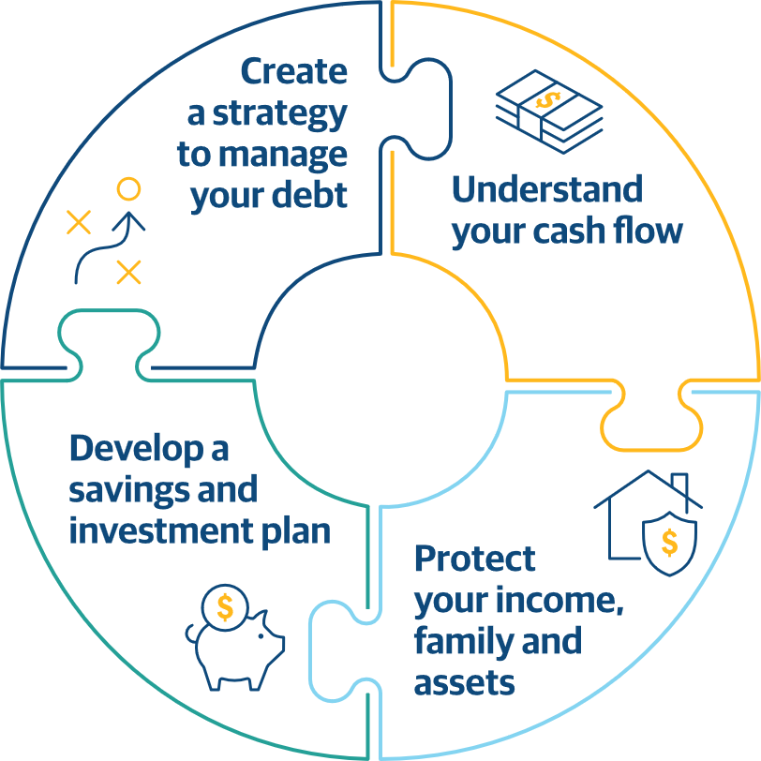
Four Steps to Building a Strong Financial Foundation
1. Save
2. Spend
5. Give
3. Grow
4. Protect
4
Notes:
Understanding and following a few basic steps can help improve how you handle your finances now, and down the road. These include...
#1 - Understanding your cash flow.
# 2 - Protecting your income, family, and assets.
#3 - Developing a savings and investment plan
#4 - And Creating a strategy to manage your debt
Today we are going to cover all of these strategies, so you can start to build a strong financial foundation.

Slide 5
Would you find an app that can track your monthly expenses helpful?
5
Notes:
Raise your hand if you track your expenses so you know how much money you have coming in and going out each month.
[Audience Responds]

Slide 6

Understand Your Cash Flow
6
Notes:
Let’s start with “Understand Your Cash Flow”. We’re talking about managing the money you have, to cover what you need, what you owe and what you want.
Your cash flow refers to how much money you have coming in and going out each month. The goals is to have positive cash flow, meaning you spend less than you earn, leaving some money left over each month.
Raise your hand if you track your expenses so you know how much money you have coming in and going out each month.

Slide 7
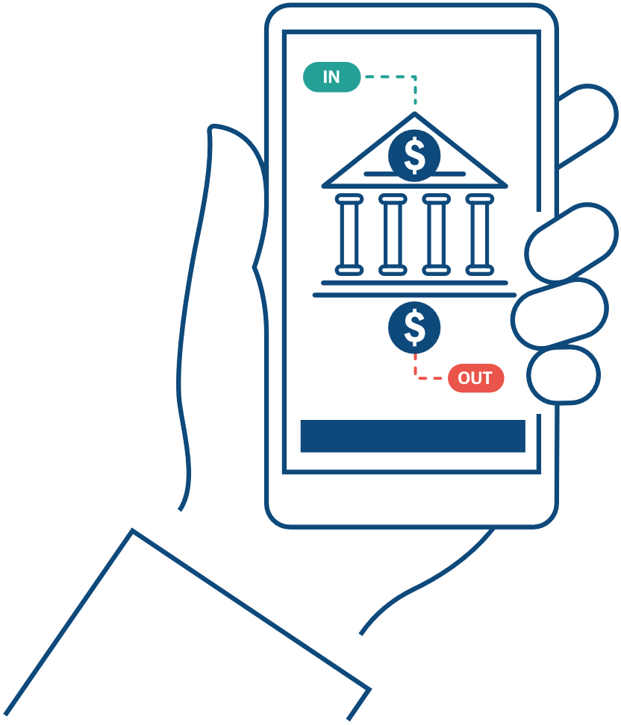
Track Expenses
Money Coming In
Money Going Out
Don’t forget about expenses that happen only a few times a year – they can add up, too!
Notes:
Spending wisely starts with that – having clarity on what’s coming in and what’s going out.
It’s pretty easy to do, too. Start by taking an inventory of all the ways you’re spending money. You can download an app to track your spending, use the budgeting worksheet I’ve provided, or save and track all your receipts for at least three months. And don’t forget about the expenses that might happen only once or twice a year, because those can add up, too.

Slide 8



Compare Spending to the 20/60/20 Rule
20%
60%
20%
Saving/Investing
Essential Expenses (housing, food, insurance, loan debt)
Discretionary Expenses (entertainment, travel, personal care)
If your current spending doesn’t align, look for ways to adjust.
8
Notes:
Then compare your spending to the 20/60/20 rule. If you look at the budgeting worksheet, you can see how expenses fit into that rule.
Saving/Investing: 20 percent (or more) of your gross income should be set aside each month for saving and investing. In order to make saving a habit, you want to save an amount first, before you start spending on essentials and fun.
Essential Expenses: No more than 60 percent of your take-home pay should be spent on essential expenses. This includes things like housing, transportation, food, clothing, your kids, health care and insurance. It also includes money spent paying down debt, such as car loans, student loans and credit card balances.
Discretionary Expenses: This still leaves you with 20 percent of your take-home pay that you can spend on the fun stuff – the nice-to-haves like going out to eat, the new technology you’ve been eyeing, entertainment, personal care, or the vacation you’ve wanted to go on.
If your current spending doesn’t line up with the 60/20 in this rule, don’t worry. If you can make the 20% savings a habit, you’ll do just fine. Any less, and you might have some decisions to make about where you can adjust your spending.
What questions do you have about spending and cash flow?

Slide 9

What causes matter most to you?
Where would you like to make a difference?
Notes:
For many people, giving back is important and it can take many forms – from volunteering your time or providing financial donations. No matter what organizations you’re inspired to help, it should be something you plan for. If financial support is a priority for you, these donations should be included in your essential expenses budget which we established earlier is 60 percent of your take-home pay.

Slide 10

Protect your income, family, and assets
10
Notes:
What do you want to protect? There are two big things that you need to consider protecting: your paycheck and your loved ones. Think about your goals – both short-term and long-term. What would happen to them if you became sick or injured and could no longer work? Would you have a good shot at reaching them?
I know – this isn’t something anyone likes thinking about, but it is a possibility. So, let’s get into what we can do about it.
[Audience questions]
What about the type of assets you own? Do you insure the asset? For example, do you own a car?
Do you have insurance for the car? Why? Possible answer: To replace it if I get into an accident.
[Exercise] To help them see the value of their income, take out your phone and use the calculator to multiply 65-age X current salary. Is that worth more or less than your car? Answer: More. Are you insuring your income so that if something happens to you, you can replace the lost income?

Slide 11
Protect Your Ability to Earn an Income
1 in 4
people will be disabled at some point in their career.²
² U.S. Social Security Administration Fact Sheet, July 2019
11
Notes:
First, you can protect your income with disability income insurance. Most people are surprised to hear that one in four people will become disabled at some point in their career.
(Ask the audience): What do you think are some of the causes of DI claims?
(Listen to their responses.)
The top causes include musculoskeletal and back problems (31%) and cancer (19%).
Other causes are pregnancy complications (3%), injuries (e.g., from a car accident or sports) (7%), and strokes (8%?).
(Source: NM’s study on all client claims from 2016-2020)

Slide 12
How many of you have group disability income insurance from your employer?
Notes:
How many of you have group disability income insurance from your employer?
[Audience Responds]
Do you know what percentage of your salary that insurance would cover if you became disabled?
[Audience Responds]

Slide 13
Protect Your Ability to Earn an Income
Group disability income insurance through your employer
Most group plans have some sort of cap ...
Usually about 60% of your salary.
60%
Notes:
Most employers’ insurance covers only about 60 percent of your salary, not including your bonus, which leaves you with at least 40 percent less money coming in. Would about 60 percent be enough for you to live on? [pause]
Probably not. But by getting your own supplemental disability income insurance, you can cover more of your income that your employer does not. It’s one of the most affordable insurances you can get, and it helps cover one of your most important assets.

Slide 14
Protect Your Loved Ones
What if you weren’t there to financially support your family?
Consider owning additional life insurance, outside employer plans.
If you decide to buy life insurance, make sure you understand the different types.
Notes:
The second piece of protection is for your loved ones if something should happen to you. Like disability income insurance, you may have some life insurance coverage through work, but is it enough to protect the financial well-being of the people who depend on you?
Think about what you’d want to have covered if something happened and you weren’t here anymore to support your loved ones. Would you want to cover funeral expenses? Debt, like your mortgage or credit card bills? Your kid’s education?
If you determine that you might need more life insurance, beyond what might be offered through work, make sure you talk to a financial professional first, so you understand the different types of life insurance and what kinds of benefits make the most sense for your situation.
Are there any questions?

Slide 15

Develop a savings and investment plan
15
Notes:
Saving is an important part of financial security because it helps you to build up funds to cover your goals and the surprises life throws at you. It also helps you afford the life you want tomorrow. Those are all important things, but of course you can’t save all your money … so how much should you save?

Slide 16











How Much Should I Save Each Month?
=
20%
or more
Write your goals down -- and be specific!
16
Notes:
The general rule of thumb is to allocate 20 percent of your gross income to saving and investing. Create a habit of saving by saving first, then spending what's left. Have a goal of saving 20% or more of head of household gross income.
But, of course, the amount you should be saving depends on what you want for the future. Think about your goals. Write them down – and be specific.
Why is it important to be specific? Let’s say that one of your goals is to buy a home. If that’s all you’ve decided, you know you need to save for a down payment, but you don’t really have an idea of how much or how long you have to save for it. But if you think about whether you want a house or a condo; where you want to be located; how many bedrooms you need; what other amenities are important to you; and whether you want to buy in one, five or ten years, you can get a good idea of how much your dream home might cost and how quickly you need to save that money.
It’s the same with any of your goals. The more detail you can picture that goal with, the better chance you have of reaching it.

Slide 17
How many of you have an emergency fund?
17
Notes:
[Audience Poll 1] Does anyone here have an emergency fund?
[Audience Responds]
[Audience Poll 2] How many weeks/months of your expenses could you cover (with cash) if you stopped working?
[Audience Responds]
[Optional Follow-On Question]
How many weeks or months of your expenses could you save (with cash) if you stopped working?

Slide 18
Emergency Fund
There will always be unexpected expenses.
32% of all Americans wouldn’t be able to cover an unexpected $400 expense without using a credit card or borrowing the money — which can cost you even more money in interest.¹
¹ Source: Federal Reserve Report on the Economic Well-Being of U.S. Households, May 2022
https://www.federalreserve.gov/publications/files/2021-report-economic-well-being-us-households-202205.pdf
18
Notes:
No matter what your goals are for the future, your top saving priority should be to establish an emergency fund.
Here’s why emergency funds are so critical. No matter how carefully you plan your finances, there will always be unexpected expenses: car repairs, vet bills or a trip to the ER. And yet surveys show that 32 percent of Americans couldn’t cover an unexpected $400 expense without using a credit card or borrowing the money – which can cost you even more money in interest.
Okay, another question … How much money do you think you need in your emergency fund?
[Audience Responds]

Slide 19





















Emergency Fund
General Guideline:
Keep an equivalent of six months of living expenses in an account you can access easily.
1
2
3
4
5
6
19
Notes:
The goal is to have six months of living expenses in an account you can access easily, like a savings or checking account. It’s okay if you don’t have that yet. You can start small and add to it over time – but try to build up to six months of expenses.
Are there any questions about saving?

Slide 20




Investing
Invest in ways that match your goals, your timeline
and your tolerance for risk.
20
Notes:
To achieve your goals, you’ve got to save in ways that will allow your money to grow. Typically, that means investing.
We’re going to cover this at a very high level, and there is a lot of nuance to how you invest and what type of account you use. I’m always available to chat about this if you have more questions.

Slide 21
Investing: The Value of Starting Early
Illustrated effect of compounding growth of $100 over time at 6% rate of return.
$208,669
Growth of Savings
$106,596
$49,599
Age
The sooner you start, the harder your money can work for you.
All investments carry some level of risk, including the potential loss of principal invested. Hypothetical example intended to illustrator the concept of compounding. It is not representative of any specific investment.
21
Notes:
Investing is particularly important when saving for the long term, like a down payment on a home, your kid’s education and your own retirement. Starting small is okay, but the sooner you start saving for your future, the better. That’s because it allows you to take full advantage of compounding, which is earning interest on interest over time – and it can make a big difference.
Let’s say you turn 45 years old and decide to start investing $100 a month. For simplicity, we’ll say you get a 6 percent annual return, including compound interest. With that return, you can double your money by the time you turn 65.
But if you started saving 10 years earlier, at age 35, you could triple your money – because you’ll be earning interest on your interest.
And if you started at age 25, you could quadruple your money by age 65.
The bottom line is this: Start saving as early as possible. We’re all living longer these days, and women tend to live longer than men. That’s great news – who doesn’t want to live a long life? But it also means you may have to cover the cost of 30 or more years in retirement. That’s a long time to live off your savings, so the earlier you can start building up those funds and taking advantage of compounding, the better!

Slide 22

Create a strategy to manage your debt
22
Notes:
Another option is to free up money you can put toward savings—and one way to do that is to be smarter about your debt. If you have some debt and manage it responsibly, money you free up can be used to help you get ahead financially. That’s why you’ll often hear people say, “Not all debt is created equal.”

Slide 23
Eliminate Credit Card Debt
Set a goal to pay off all credit card debt within five years.
Always make at least the minimum monthly payment on all your credit card bills.
When possible, pay more than the minimum on your high-interest credit cards to pay them down faster.
23
Notes:
Credit card debt is an example of bad debt because the interest rates are typically very high. So, credit card debt is one of the first things we want to tackle when developing a debt management strategy. The goal should be to pay off all credit card debt within five years.
Always make at least the minimum monthly payment on your credit card bills.
If you are able, pay more than the minimum, starting with your credit card with the highest interest rate. This will help you pay credit card debt down faster.
By taking these steps, you’ll save money over the long run. And again, that will free up some money you can use for other goals.

Slide 24
Managing Student Loan Debt
Loan Forgiveness
Loan Consolidation
Public Service Loan Forgiveness and Teacher Loan Forgiveness
Meet certain criteria
May be able to lower monthly payments by extending the length of the loan
May get lower interest rate
24
Notes:
Student loan debt is one example of good debt because it’s considered to be an investment in yourself. And the expectation is that the investment will pay for itself many times over during your lifetime, with better opportunities and higher income.
Still, if you feel buried under the weight of student loan debt, here’s something to consider: If you have federal loans, you can change your repayment plan —any time, for free.
There are a few other options that may be available to you, as well. The first is loan forgiveness. There are two types of loan forgiveness programs for federal student loans: Public Service Loan Forgiveness and Teacher Loan Forgiveness. In both cases, you could have your loan balance forgiven if you meet certain criteria.
You may also be able to consolidate your loans and refinance. In this case, you’d work with a bank, credit union or lending agency to take out a new loan to pay off your old loan. In the process, you may be able to lower your monthly payment by extending the length of the loan; and if you have good credit and income, you may also be able to lower your interest rate.

Slide 25

Managing Mortgage Debt
Refinancing Mortgage:
Lower interest rate
Lower payments
Shorten term of loan (you save on interest but will be paying a higher monthly payment)
Paying extra on the principal:
Make sure lender allows for early repayment
May affect tax deductions
$300k
+
Pay $240 Extra Each Month
=
$57,000
saved in interest &
Mortgage
loan reduced by
7 years!¹
1 Source: Bankrate – http://www.bankrate.com/calculators/home-equity/additional-mortgage-payment-calculator.aspx
Notes:
A mortgage is generally considered good debt, for a couple of reasons: You’re building equity in something that will (hopefully) grow in value over time. Also, you may be getting tax deductions for the interest and property taxes you’re paying.
Still, some people would be willing to give up the deductions if it meant they could get out from under their mortgages more quickly. If you’re thinking about this, make sure you have eliminated credit card debt and have any other debt under control. Then, you’ve got a couple of options:
Refinancing: If you’re locked into a longer-term mortgage, like a 30-year, refinancing might be an option for you.
You may be able to get a lower rate, lower your payment or shorten the term of your loan, especially if your credit score has improved or rates have fallen since you first got your mortgage. But remember, if you shorten the term of your mortgage to a 15-year, for example, you’ll save on interest over the long term, but you’ll be paying a higher monthly payment.
Paying Extra Principal: If you want to keep your mortgage as is but want some flexibility to pay extra when you can, think about paying a little extra principal each year or even each month. You can significantly reduce the amount of interest you pay over the life of your loan and decrease the term of your loan. For example, if you had a $300,000 mortgage and paid $240 extra each month on a new 30-year mortgage at 4 percent, you would save yourself over $57,000 in interest—and your mortgage payments would be cut by seven years, too.¹
Before you make extra payments, be sure to check if your lender allows for early repayment. I recommend talking with your tax accountant on any impact to your tax deduction as well.
Lastly, keep in mind that refinancing or paying extra means you do not have easy access to those funds, as they are tied up in your real estate. That’s why it’s an option only if you have your other savings needs and debt under control.
[Audience Participation] Okay. We’ve covered quite a bit of ground here in the Spend section. Take a moment to review the Freeing Up Money and Managing Debt section on your worksheet. I’d like you to highlight anything you’d like to follow up after this session.
And we have lots of follow-up material I can make available to you after this presentation: a budget worksheet and guides on credit scores and managing student loan debt.
¹Source: bankrate. http://www.bankrate.com/calculators/home-equity/additional-mortgage-payment-calculator.aspx

Slide 26
RECAP: Four steps to building a strong financial foundation
2. Spend
5. Give
3. Grow
4. Protect
26
Notes:
Now that you’ve begun building a strong financial foundation, consider getting a financial plan. Having one personalized to you can help you reach all of your goals. Not only can we show you how to pay down debt, we can help you grow your money and protect everything you’ve worked so hard for, too — so your finances can take you even further.
The 4 Steps (recapped)….
#1 - Understand your cash flow.
#2 - Protecting your income, family, and assets.
#3 - Develop a savings and investment plan
#4 - Create a strategy to manage your debt

Slide 27
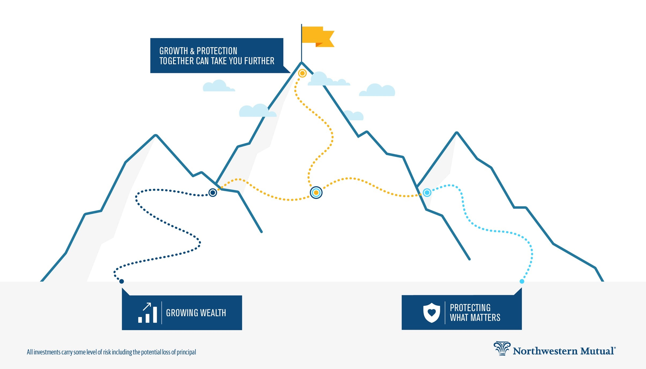
Now that you have a foundation, let’s strive to achieve all your financial goals with confidence.
1. Save
2. Spend
5. Give
3. Grow
4. Protect
Notes:
Getting a handle on your finances may seem overwhelming, which is why many people find it helpful to work with a financial professional (like me) who can help you prioritize your goals and create a plan that’s unique to you. Then, when you earn a bonus or find yourself with an extra $100/month, you can be confident that you’re using the money in the best way to support your goals.
Are there any questions?
Remember, I’m here for you and can help you tailor your plan from a wide range of financial options in order to protect what matters most today and tomorrow, grow your wealth, and reach your financial goals.

Slide 28
Thank You
Northwestern Mutual is the marketing name for The Northwestern Mutual Life Insurance Company (NM), Milwaukee, WI
(life and disability insurance, annuities, and life insurance with long-term care benefits) and its subsidiaries. Northwestern Long Term Care Insurance Company (NLTC), Milwaukee, WI (long-term care insurance), subsidiary of NM. Northwestern Mutual Investment Services, LLC (investment brokerage), subsidiary of NM, broker-dealer, registered investment adviser, member FINRA and SIPC. Northwestern Mutual Wealth Management Company® (NMWMC), Milwaukee, WI (investment advisory and trust services), subsidiary of NM and federal savings bank.
Notes:
Thank you so much for being here today. I hope you leave today feeling motivated to take control of your financial future. I’ll be here for a little while, so if you have any questions you’d like to ask individually, come on up. And, of course, if you’d like to talk more in depth about creating a financial plan that can help you reach your goals, let’s make an appointment. I’m happy to set that up now, or I’ve got business cards, so you can contact me later. Thank you!

