Slide 1
Retirement Benefits Open Forum
March 7, 2019
Notes:
Main title: 44 pt. Calibri
Presenter Name: 20 pt. Calibri
Presenters Title: 20 pt. Calibri Italic

Slide 2
Today’s Topics
Introduction
Kim Sestili, Staff Council Benefits Committee Co-Chair
Lynn DeFabio, Staff Council Benefits Committee Co-Chair
Overview of Social Security
Jack Kennedy, Director of Benefits
Overview of Medicare, CMU Retiree Medical Offerings, CMU Retirement Savings Plans
Shawn Graham, Retirement Specialist
What Happens to My Benefits When I Leave?
Becky McGhee, Senior Benefits Administrator

Slide 3
Overview of Social Security
Jack Kennedy, Director of Benefits

Slide 4
Social Security
Social Security provides:
retirement benefits when someone retires;
benefits to survivors when someone who has paid into the OASDI fund passes away; or
benefits to someone who becomes disabled.
Social Security is dependent on the amount of years the participant worked in a job that contributed to Social Security and the amount the participant earned over those years.

Slide 5
Social Security: Retirement Benefits
Age To Receive Full Social Security Benefits (FRA)
1937 or earlier | 65
1938 | 65 and 2 months
1939 | 65 and 4 months
1940 | 65 and 6 months
1941 | 65 and 8 months
1942 | 65 and 10 months
1943 to 1954 | 66
1955 | 66 and 2 months
1956 | 66 and 4 months
1957 | 66 and 6 months
1958 | 66 and 8 months
1959 | 66 and 10 months
1960 and later | 67
Benefit payment based on age at commencement
Benefits as early as age 62 and as late as age 70
Permanent reduction in benefits if taken early
If born after 1937 — Full Retirement Age (FRA) is later than age 65
Example (born in 1962):
Eligible at age 62 = 70% of FRA benefit
FRA (age 67) = 100%
Age 70 = 124% of FRA benefit
https://www.socialsecurity.gov/planners/retire/agereduction.html

Slide 6
Social Security: Statements and Contact Info
Social Security statements summarize earning history and provide a picture of the monthly benefit likely at age 62, FRA and age 70.
Available on my Social Security
Sign up for account at www.ssa.gov
Who to contact:
Call: 1-800-772-1213
Email: www.ssa.gov

Slide 7
Overview of Medicare
Shawn Graham, Retirement Specialist

Slide 8
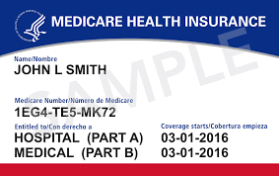
Overview of Medicare
Medicare Eligibility
65 years of age and older
OR
Under 65 years and receiving disability benefits from Social Security Administration
OR
Under 65 years and diagnosed with End Stage Renal Disease

Slide 9
Overview of Medicare
Current Parts of the Medicare System
Part A: Hospital Care
Covers in-patient care/services
Skilled nursing care
Some home health care
Hospice care
Part B: Medical Care
Covers out-patient care/services
Preventive services
Diagnostic tests
Durable medical equipment

Slide 10
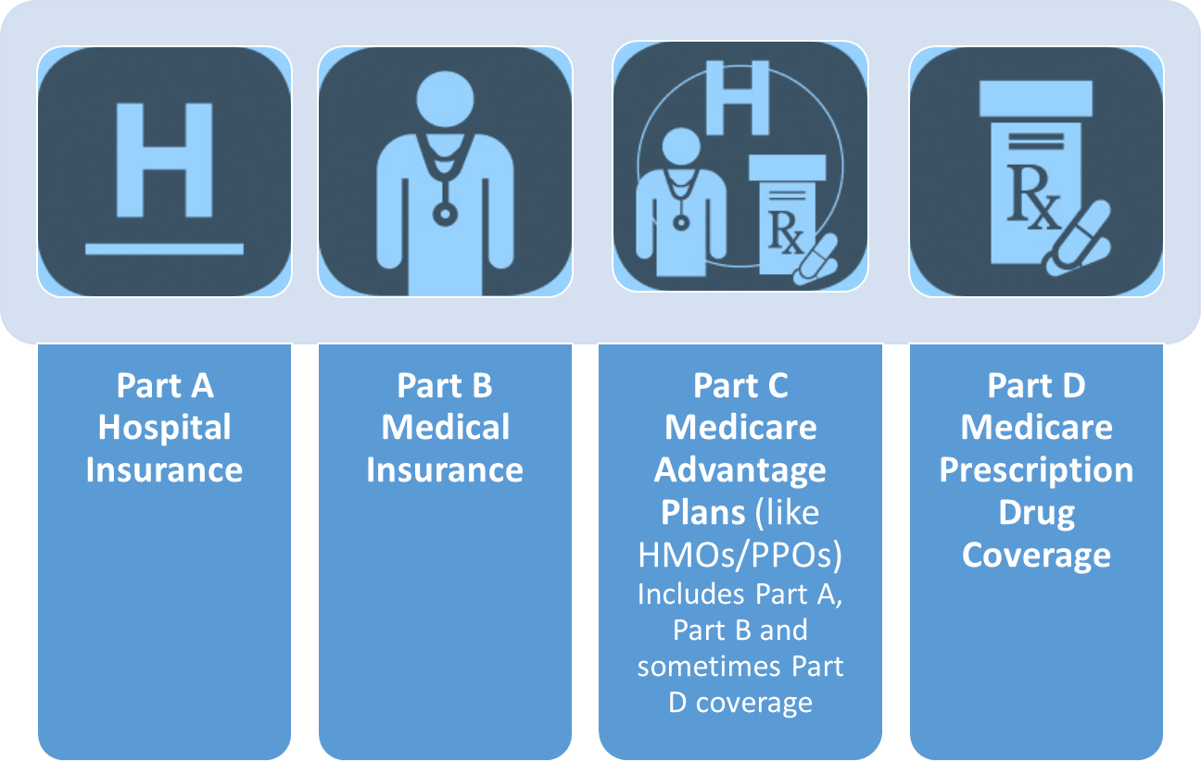
Overview of Medicare
Current Parts of the Medicare System

Slide 11
Overview of Medicare
Enrollment in Medicare is Administered by Social Security Administration
Social Security Administration
Call: 1-800-772-1213
Email: www.ssa.gov
Medicare
Call: 1-800-633-4227
Email: www.medicare.gov

Slide 12
CMU Retiree Medical Offerings
Shawn Graham, Retirement Specialist
Notes:
NOTE: These are current offerings, subject to change.

Slide 13
Retiree Medical Eligibility
To participate, you must:
Be eligible for full-time health benefits at time of retirement
Be at least 60 years of age
Have at least 5 years of service with the university
If you retire with eligibility for retiree medical, you retain eligibility to enroll in the plan even if you do not enroll at retirement
Eligible dependents include:
Your spouse/registered domestic partner
Your unmarried children up to their 26th birthday
Your unmarried children of any age who, upon attainment of age 26, were covered under the particular benefit and were disabled
Notes:
Reason for termination doesn’t have to be retirement.
Surviving spouses continue to be eligible.

Slide 14
Pre-65 Retiree Medical
Coverage provided through COBRA
Pre-65 retirees (and their eligible dependents) are offered retiree medical coverage through COBRA up until age 65
Plan offerings are the same as active employee coverage
Participants pay full COBRA premiums; no subsidy
Information on COBRA coverage, including premiums, can be found in the Benefits Guide
Annual open enrollment opportunity
Notes:
Spouses can stay on separately until they reach age 65.

Slide 15
Post-65 Retiree Medical
Option 1
Medicare Advantage Plans
Enroll in one of three Medicare Advantage Plans sponsored by CMU
HMO options only available to Pennsylvania-area retirees
$20 monthly subsidy per person with 15 or more years of service
OR
Option 2
Major Medical/Supplemental Rx
Need to enroll on your own (and at your own expense) in a Medigap or Medicare Advantage plan
Available in and outside Pennsylvania area
$0 premium with 15 or more years of service
Both Options Require Enrollment in Medicare Part A and B

Slide 16
Option 1 — Medicare Advantage Plans
Three Medicare Advantage Plans available:
Aetna PPO
Highmark BC/BS Security Blue HMO
UPMC for Life HMO
HMO networks only available in Pennsylvania; PPO option has a nationwide network
HMOs must use in-network providers
Includes prescription drug coverage
No need to purchase additional coverage
$20 monthly subsidy per person with 15 or more years of service
Plan details can be found in Retiree Medical Workbook

Slide 17
Option 2 — Major Medical/Supplemental Rx
Supplements the coverage for retirees who have enrolled in coverage outside the university
Available in and outside Pennsylvania area
Major Medical — administered by Highmark BC/BS
Covers 80% of eligible expenses
$100,000 lifetime maximum
Supplemental Rx — administered by CVS/Caremark
Covers 80% of eligible expenses after $250 deductible
$0 premium with 15 or more years of service
Must also enroll on your own in a Medigap or Medicare Advantage Plan
Notes:
Tertiary plan; helps offset out of pocket expenses after your supplement pays.

Slide 18
Part-Time Employment with the University
If you transition from full-time to part-time, and then subsequently retire …
You are NOT eligible for retiree medical
If you retire with eligibility for retiree medical, and are subsequently rehired part-time …
At < 17.5 hours/week (non-benefits-eligible): You RETAIN eligibility for retiree medical
At ≥ 17.5 hours/week (part-time benefits-eligible): You LOSE eligibility for retiree medical
Notes:
46.7% effort = 17.5 hours

Slide 19
Additional Information
Visit Retiree Benefits Webpage
https://www.cmu.edu/hr/benefits/retiree.html
Review Retiree Medical Workbook
Attend an Upcoming Ready to Retire! Workshop
Thursday, April 4, 2019
Notes:
Contact Benefits Office to make an appointment; introduce Shawn.
Pick up Retirement Planning Checklist.

Slide 20
CMU Retirement Savings Plans
Shawn Graham, Retirement Specialist

Slide 21
CMU Retirement Plans
Carnegie Mellon University Faculty and Staff Retirement Plan (FSRP)
403(b) plan for US citizens and US permanent residents
University contributions — TIAA or Vanguard
Employee contributions — TIAA and/or Vanguard
Carnegie Mellon University 401(k) Plan (401(k) Plan)
401(k) for non-resident aliens
University and Employee contributions — Vanguard only

Slide 22
Things to Consider Before Retirement
Vesting
University Contributions: Three years of service, 1,000 hours in each of three anniversary years (most full-time employees vest in 2.5 years)
Beneficiaries
Review and update your beneficiaries
TIAA — You can have up to six contracts depending on your length of employment with the university. You must indicate your beneficiary(ies) on each contract.
Vanguard — If you have both 401(k) and FSRP, you must designate beneficiary(ies) for each plan.

Slide 23
Things to Consider Before Retirement
In-service distributions available prior to retirement
Employee Supplemental Contributions:
Age 59.5
Loans (through TIAA only)
Hardship
Loans are not available in the CMU 401(k) Plan
University Contributions:
Age 59.5 only with hardship reason

Slide 24
Things to Consider Before Retirement
Are You On Target?
Faculty and staff can contribute up to 100% of their pay to the plan(s)
Current IRS annual maximum is $25,000 for anyone age 50 or older
Are you contributing enough to replace your salary at retirement?
Review your current contribution % in Workday
Increase your contribution % if you can

Slide 25
Things to Consider Before Retirement
Schedule an on-campus meeting with TIAA or Vanguard to discuss:
Are you on target for retirement?
Review your investment mix
Elimination of debt
Distribution options
Taxation

Slide 26
Things to Consider Before Retirement
Attend on-campus CMU-sponsored information sessions:
Ready to Retire
Next session: Thursday, April 4, 2019
TIAA/Vanguard Informational Workshops
Next sessions:
Vanguard — March 18, 2019
TIAA — April 17, 2019
Register via FocusU: https://focusu.skillport.com/

Slide 27
Retirement Resources
TIAA
Call: 1-800-842-2776
Website: www.tiaa.org
Individual Consultation: 1-800-732-8353
Vanguard
Call: 1-800-523-1188
Website: www.retirementplans.vanguard.com
Individual Consultation: 1-800-662-0106, ext. 14500

Slide 28
What Happens to My Benefits When I Leave?
Becky McGhee, Senior Benefits Administrator

Slide 29
What Happens to My Benefits When I Leave?
Health Plans and Flexible Savings Accounts (FSAs)
Coverage ends last day of month in which employment ends
Continue coverage under COBRA for up to 18 months
Life Insurance Plans
Coverage ends last day of month in which employment ends
Opportunity to convert to individual policy with MetLife
Disability Plans
Coverage ends last day of employment
Paid Time Off (PTO)
Earned but unused PTO (up to annual entitlement) is paid out upon separation
Notes:
Explain COBRA:
– Federal law that requires health plans to offer continuation coverage when coverage would otherwise be lost due to certain events such as:
Termination
Reduction in hours
Divorce
Death
Loss of dependent child status (age 26)
- Group health plans:
Medical/Rx
Dental
Vision
Health Care FSA
- Coverage offered must be same as current coverage; cannot change plans
Can pick and choose what plans to continue, and who to continue coverage for
- Pay 102% of premium
- Election Notice
Describes continuation rights and how to make election
Provided upon qualifying event by COBRA vendor
Must elect within 60 days
Must make 1st payment within 45 days of election
-Not common for post-65 retirees to continue Medical/Rx
Consider continuing coverage under Dental/Vision, or HCFSA

Slide 30
What Happens to My Benefits When I Leave?
Tuition Benefits for Employees
Tuition benefits will continue through the end of the current term
Tuition Benefits for Dependents
Dependents remain eligible when you retire:
If you are full-time when you retire at age 62 or later with at least 15 years of service
If you are full-time when you retire at age 65 with at least ten years of service
If you are full time when you pass away with 10 or more years of service
Notes:
Explain COBRA:
– Federal law that requires health plans to offer continuation coverage when coverage would otherwise be lost due to certain events such as:
Termination
Reduction in hours
Divorce
Death
Loss of dependent child status (age 26)
- Group health plans:
Medical/Rx
Dental
Vision
Health Care FSA
- Coverage offered must be same as current coverage; cannot change plans
Can pick and choose what plans to continue, and who to continue coverage for
- Pay 102% of premium
- Election Notice
Describes continuation rights and how to make election
Provided upon qualifying event by COBRA vendor
Must elect within 60 days
Must make 1st payment within 45 days of election
-Not common for post-65 retirees to continue Medical/Rx
Consider continuing coverage under Dental/Vision, or HCFSA

Slide 31
What Happens to My Benefits When I Leave?
Tuition Benefits for Dependents
Dependents must meet the following requirements to be eligible:
Meet IRS dependency exemption criteria
Must be born or legally adopted by the eligible staff member
Must be enrolled in an undergraduate degree program before the age of 30
Up to two children per family may utilize the tuition benefit at an outside school
An unlimited number of eligible dependent children may attend Carnegie Mellon University
Notes:
Explain COBRA:
– Federal law that requires health plans to offer continuation coverage when coverage would otherwise be lost due to certain events such as:
Termination
Reduction in hours
Divorce
Death
Loss of dependent child status (age 26)
- Group health plans:
Medical/Rx
Dental
Vision
Health Care FSA
- Coverage offered must be same as current coverage; cannot change plans
Can pick and choose what plans to continue, and who to continue coverage for
- Pay 102% of premium
- Election Notice
Describes continuation rights and how to make election
Provided upon qualifying event by COBRA vendor
Must elect within 60 days
Must make 1st payment within 45 days of election
-Not common for post-65 retirees to continue Medical/Rx
Consider continuing coverage under Dental/Vision, or HCFSA

Slide 32
What Happens to My Benefits When I Leave?
Osher Life Long Learning Institute
Non-profit organization that resides on the CMU campus but operates independently from the university
Provides courses taught by Osher members, volunteers, and faculty members on various topics
Example courses :
African Adventures: Traveling with a Medical Team
A Midsummer Night's Dream: A Dream For Us All
Origins of the US to the Second Revolution
Notes:
Explain COBRA:
– Federal law that requires health plans to offer continuation coverage when coverage would otherwise be lost due to certain events such as:
Termination
Reduction in hours
Divorce
Death
Loss of dependent child status (age 26)
- Group health plans:
Medical/Rx
Dental
Vision
Health Care FSA
- Coverage offered must be same as current coverage; cannot change plans
Can pick and choose what plans to continue, and who to continue coverage for
- Pay 102% of premium
- Election Notice
Describes continuation rights and how to make election
Provided upon qualifying event by COBRA vendor
Must elect within 60 days
Must make 1st payment within 45 days of election
-Not common for post-65 retirees to continue Medical/Rx
Consider continuing coverage under Dental/Vision, or HCFSA

Slide 33
What Happens to My Benefits When I Leave?
Osher Life Long Learning Institute
The Osher Lifelong Learning Institute at CMU accepts immediate membership from the CMU community (active employees, former employees, CMU alumni, and parents/spouse of CMU alumni)
https://www.cmu.edu/osher/membership/index.html
Notes:
Explain COBRA:
– Federal law that requires health plans to offer continuation coverage when coverage would otherwise be lost due to certain events such as:
Termination
Reduction in hours
Divorce
Death
Loss of dependent child status (age 26)
- Group health plans:
Medical/Rx
Dental
Vision
Health Care FSA
- Coverage offered must be same as current coverage; cannot change plans
Can pick and choose what plans to continue, and who to continue coverage for
- Pay 102% of premium
- Election Notice
Describes continuation rights and how to make election
Provided upon qualifying event by COBRA vendor
Must elect within 60 days
Must make 1st payment within 45 days of election
-Not common for post-65 retirees to continue Medical/Rx
Consider continuing coverage under Dental/Vision, or HCFSA

Slide 34
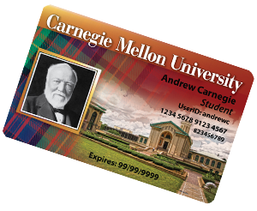
What Happens to My Benefits When I Leave?
Post Retirement Benefits — Retired Faculty/Staff ID Card
Card provides access to:
athletic facilities and equipment
campus academic buildings
CMU shuttle and escort services
tickets for athletic events, concerts, films, and other activities
university libraries borrowing privileges
Retired faculty/staff may also obtain Sponsored ID Cards for spouses or domestic partners who meet certain eligibility criteria and for their dependent children (ages 12 to 21). New Sponsored ID cards cost $20, annual renewals cost $5.
Notes:
Explain COBRA:
– Federal law that requires health plans to offer continuation coverage when coverage would otherwise be lost due to certain events such as:
Termination
Reduction in hours
Divorce
Death
Loss of dependent child status (age 26)
- Group health plans:
Medical/Rx
Dental
Vision
Health Care FSA
- Coverage offered must be same as current coverage; cannot change plans
Can pick and choose what plans to continue, and who to continue coverage for
- Pay 102% of premium
- Election Notice
Describes continuation rights and how to make election
Provided upon qualifying event by COBRA vendor
Must elect within 60 days
Must make 1st payment within 45 days of election
-Not common for post-65 retirees to continue Medical/Rx
Consider continuing coverage under Dental/Vision, or HCFSA

Slide 35
What Happens to My Benefits When I Leave?
Other Post-Retirement Benefits
Employee Assistance Program (EAP) — Free, confidential counseling and legal resources for personal and post work-life issues
Transportation — CMU bus pass deactivates upon retirement. Seniors age 65+ are eligible to ride free when presenting a Medicare Card or a Pennsylvania Senior Citizen ID card. You may obtain the Pennsylvania Senior Citizen ID card at the Downtown Pittsburgh Port Authority office.
Notes:
Explain COBRA:
– Federal law that requires health plans to offer continuation coverage when coverage would otherwise be lost due to certain events such as:
Termination
Reduction in hours
Divorce
Death
Loss of dependent child status (age 26)
- Group health plans:
Medical/Rx
Dental
Vision
Health Care FSA
- Coverage offered must be same as current coverage; cannot change plans
Can pick and choose what plans to continue, and who to continue coverage for
- Pay 102% of premium
- Election Notice
Describes continuation rights and how to make election
Provided upon qualifying event by COBRA vendor
Must elect within 60 days
Must make 1st payment within 45 days of election
-Not common for post-65 retirees to continue Medical/Rx
Consider continuing coverage under Dental/Vision, or HCFSA

Slide 36
Contact Information
Human Resources CMUWorks Service Center
Email: cmu-works@andrew.cmu.edu
Telephone: 412-268-4600 or 844-625-4600 (toll-free)
Visit In-Person: 4516 Henry Street, Pittsburgh, PA 15213
Human Resources — Benefits
Shawn Graham
Email: shawngra@andrew.cmu.edu
Telephone: 412-268-5077
Becky McGhee
Email: rmcghee@andrew.cmu.edu
Telephone: 412-268-5076
Jack Kennedy
Email: jdkenned@andrew.cmu.edu
Telephone: 412-268-1193

Slide 37
Questions?

